Slide 1
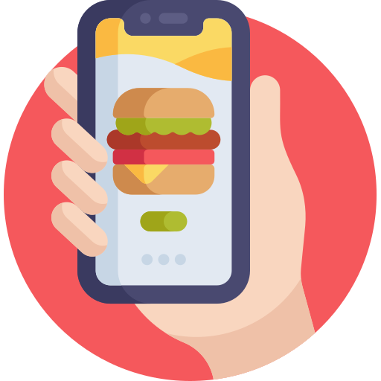
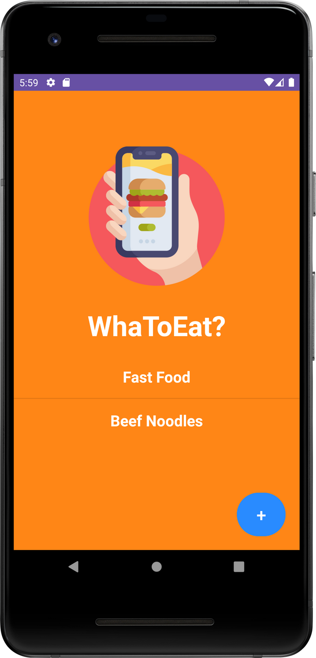
WhaToEat?
This app will save your time
1092B0012 賴致帆

Slide 2
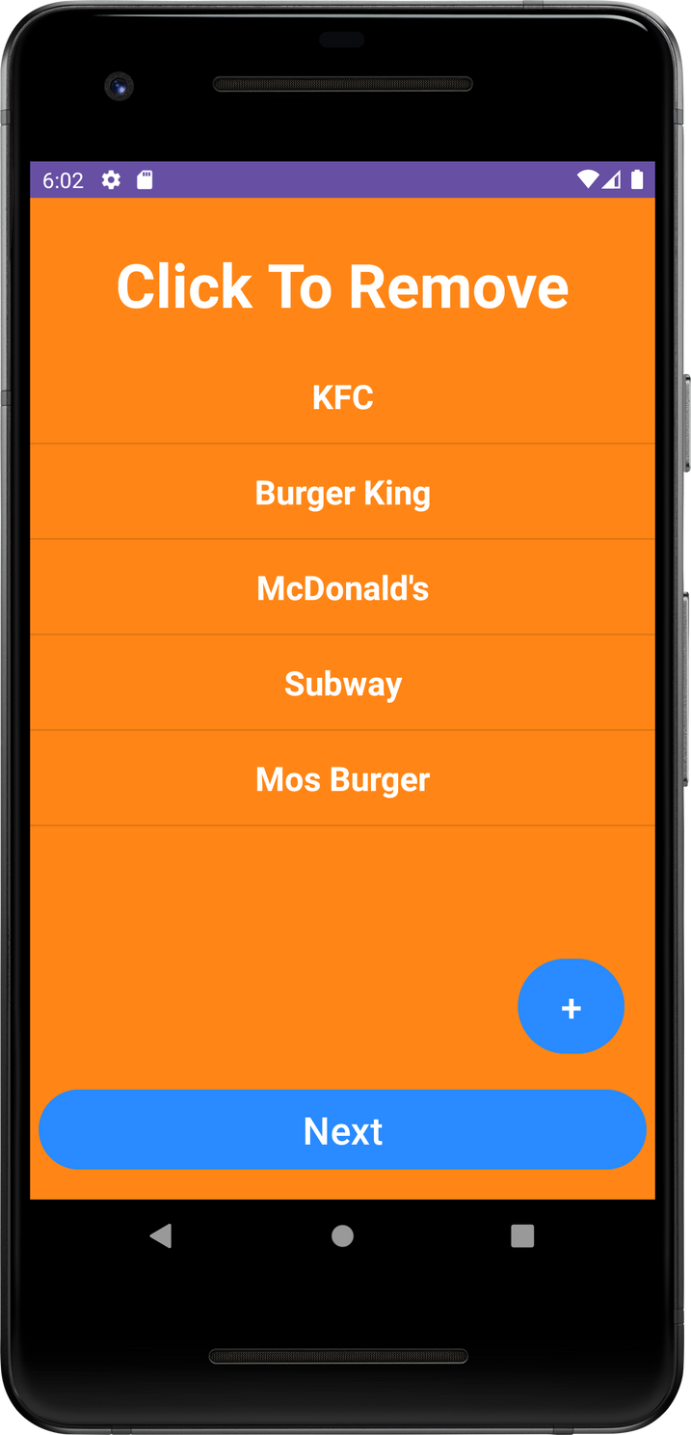
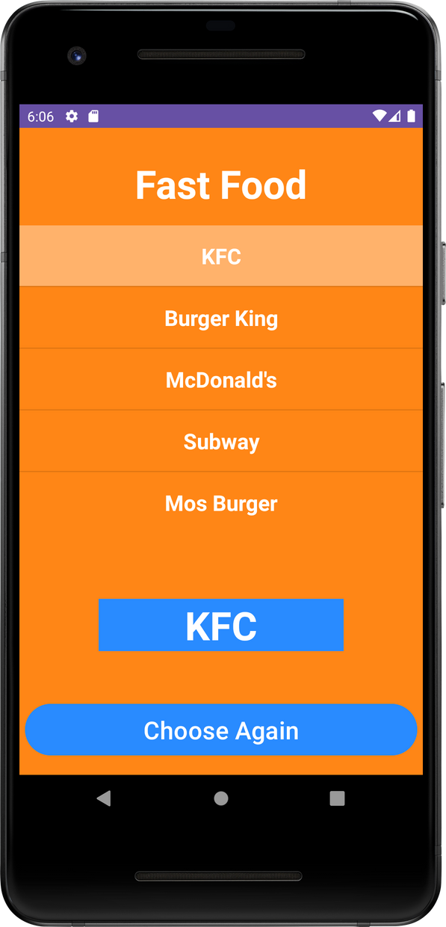
CHOOSE A LIST
PICK FOR YOU
EDIT THE LIST

Slide 3

ListView:
Choose a category.
Button:
Create new list.

Slide 4
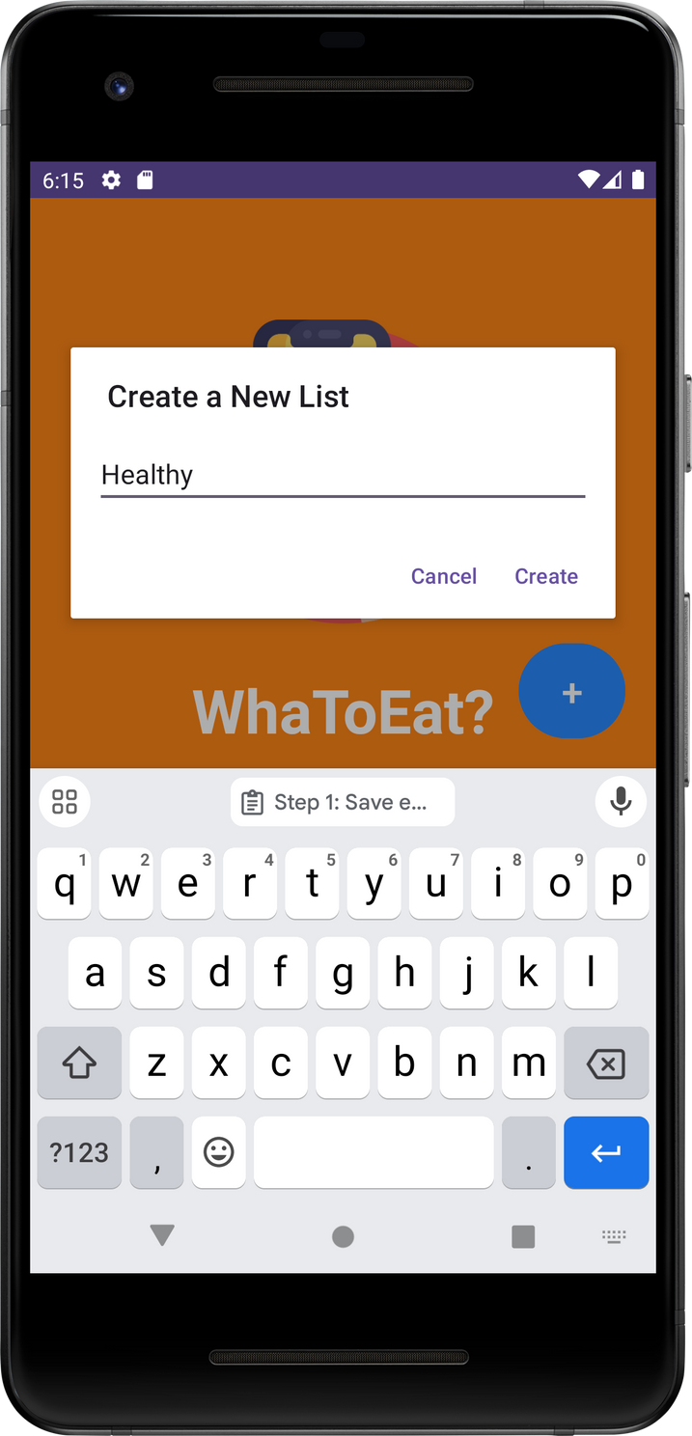
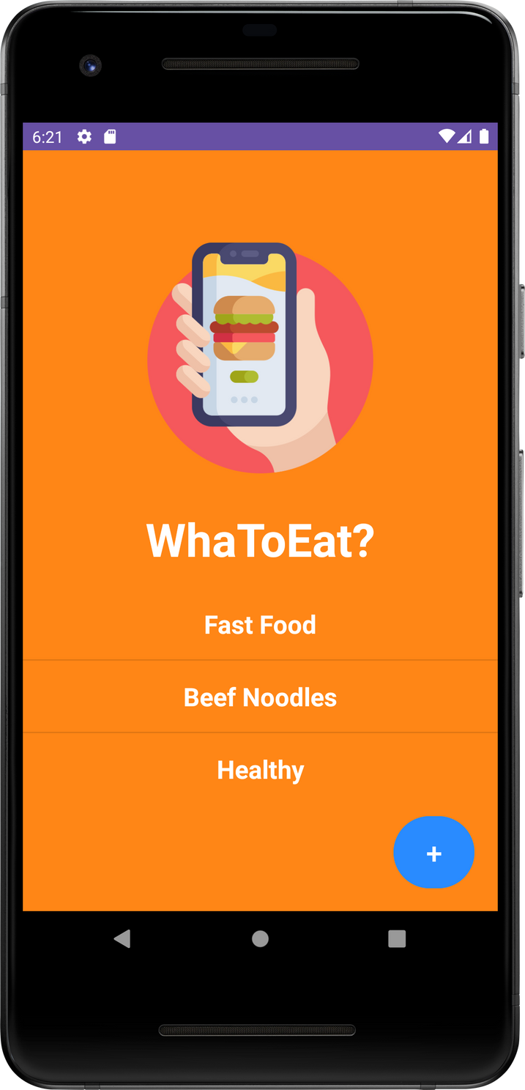
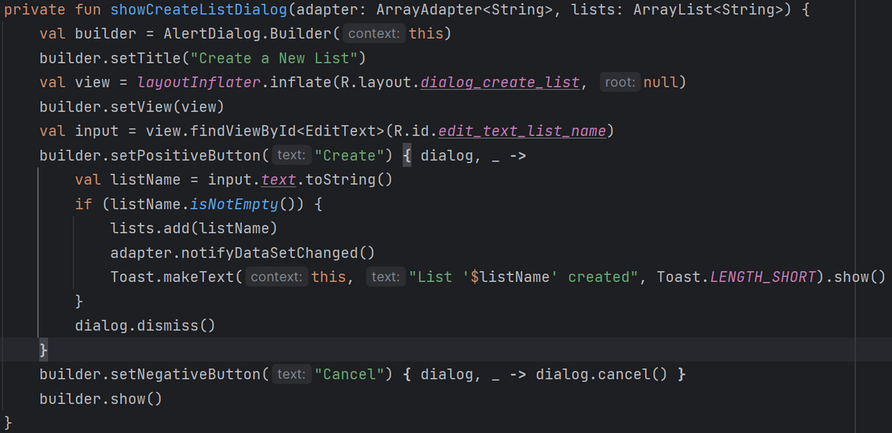
AlertDialog:
Input the list name.

Slide 5

ListView:
Click to remove an item.

Slide 6
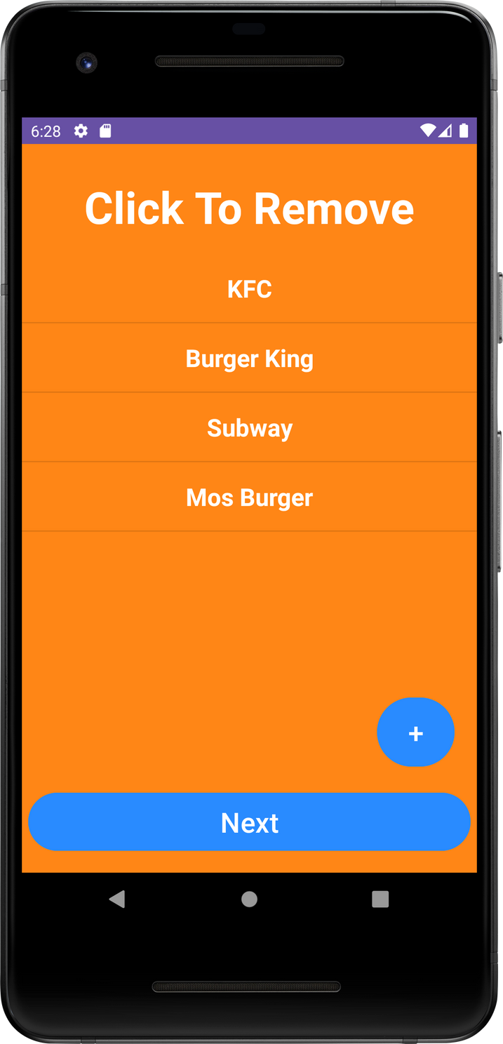

ListView:
Click to remove an item.

Slide 7
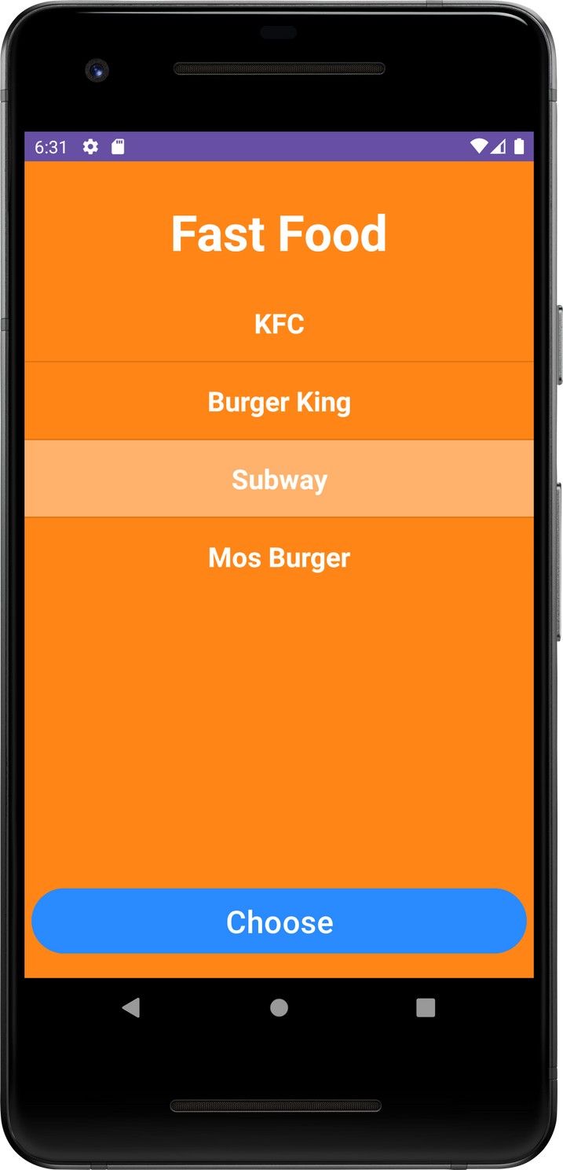
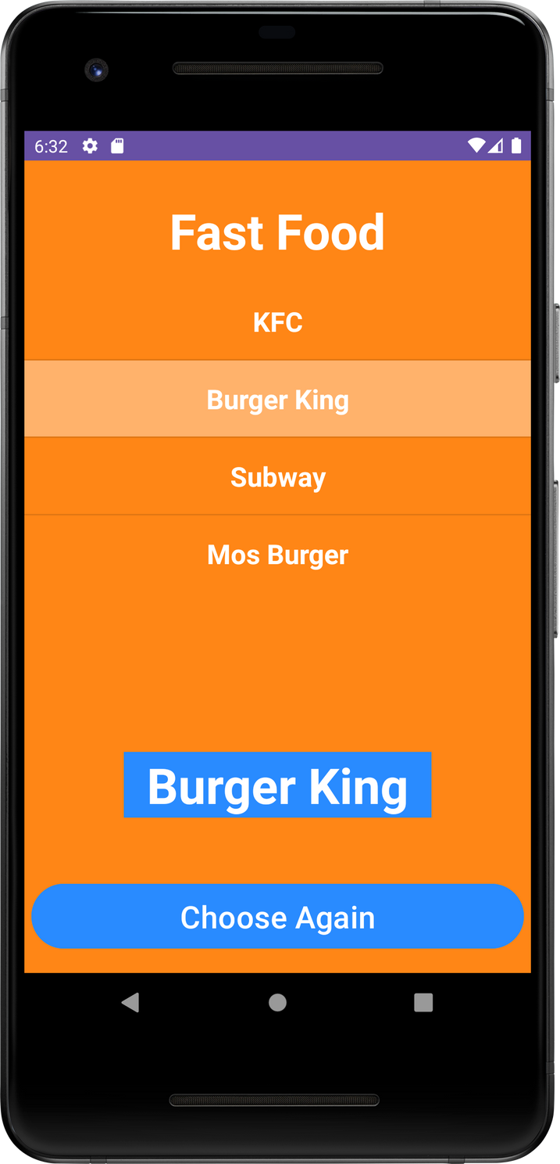

Slide 8
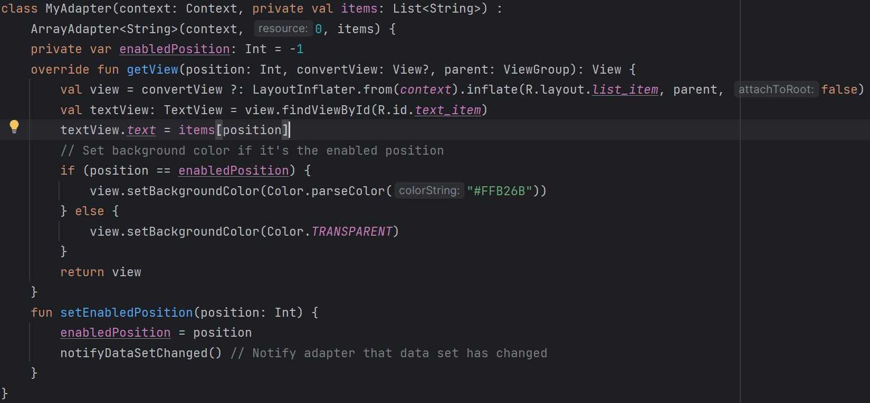
EXTRA KEY POINTS
Customize Adapter for ListView

Slide 9
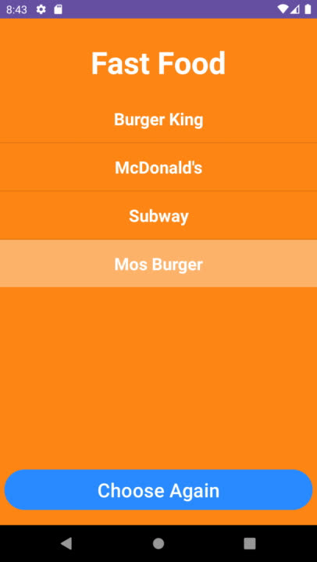
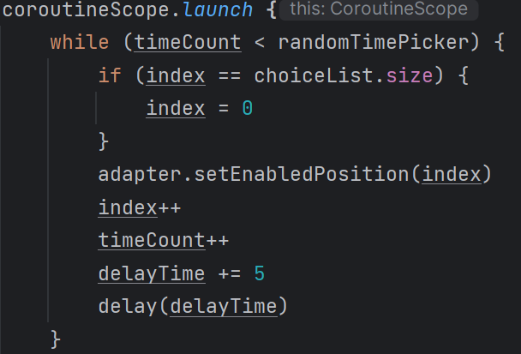
EXTRA KEY POINTS
2. COROUTINE

Slide 10

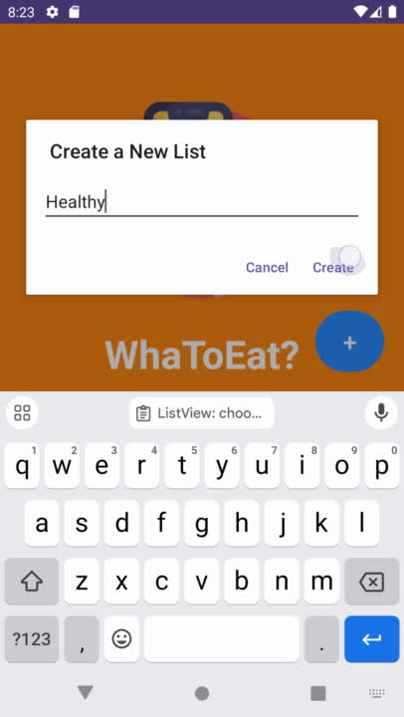

VIDEO DEMO:
youtube viedo link

Slide 11
THANK YOU

